Slide 1
6
Arrays
Objectives
In this chapter, you’ll:
Use the array data structure to represent lists and tables of values.
Define arrays, initialize arrays and refer to individual elements of arrays.
Define symbolic constants.
Pass arrays to functions.
Use arrays to store, sort and search lists and tables of values.
Be introduced to data science using basic descriptive statistics, such as mean, median and mode.
Define and manipulate multidimensional arrays.
Create variable-length arrays whose size is determined at execution time.
Understand security issues related to input with scanf, output with printf and arrays.

Slide 2
6.1 Introduction
Arrays are data structures consisting of related data items of the same type.
C’s language includes a notion of struct—a data structure consisting of related data items of possibly different types.
Arrays and structs are “static” entities in that they remain the same size throughout their lifetimes.

Slide 3
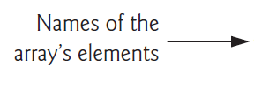
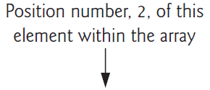

6.2 Arrays
An array is a group of elements of the same type stored contiguously in memory.
To refer to a particular location or element in the array, we specify the array’s name, followed by the element’s position number in square brackets ([]).
The first element is located at position number 0 (zero). The position number is called the element’s subscript (or index). A subscript must be a non-negative integer or integer expression.

Slide 4
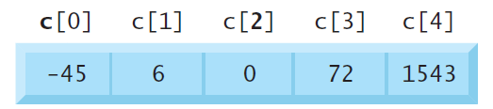
6.2 Arrays

Slide 5
6.2 Arrays

Slide 6
6.2 Arrays
An array is a group of elements of the same type stored contiguously in memory.

Slide 7
6.3 Defining Arrays
When you define an array, you specify its element type and number of elements so the compiler may reserve the appropriate amount of memory. The following definition reserves five elements for integer array c, which has subscripts in the range 0–4.
int c[5];
The definitions
int b[100];
int x[27];

Slide 8
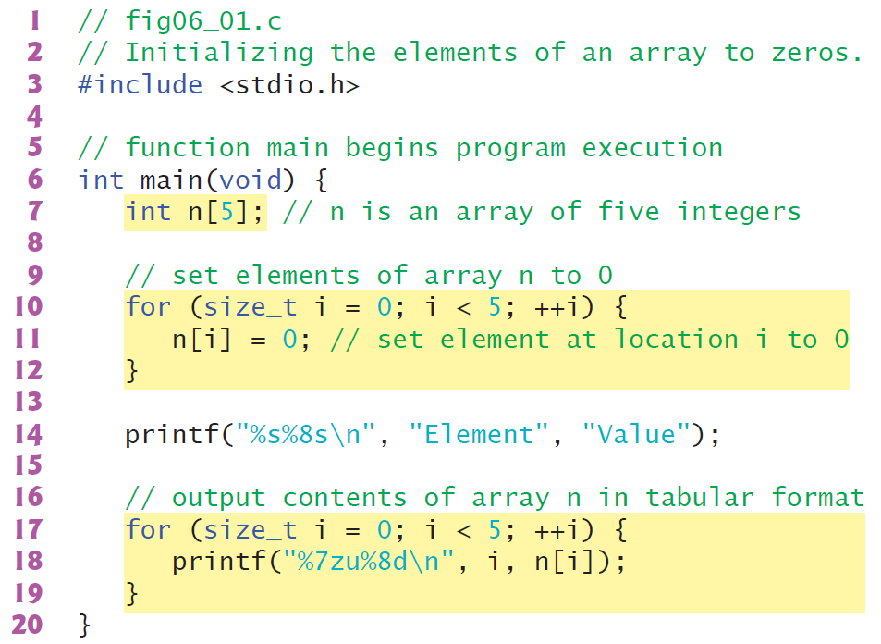
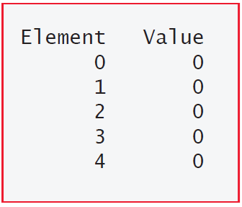
6.4 Array Examples
6.4.1 Defining an Array and Using a Loop to Set the Array’s Element Values

Slide 9
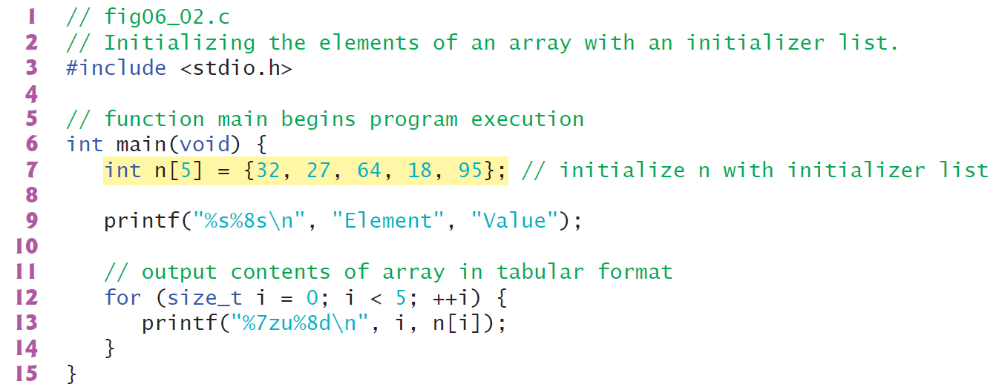
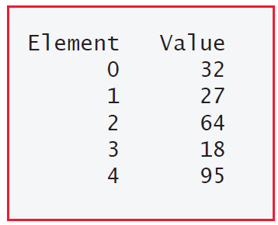
6.4 Array Examples
6.4.2 Initializing an Array in a Definition with an Initializer List

Slide 10
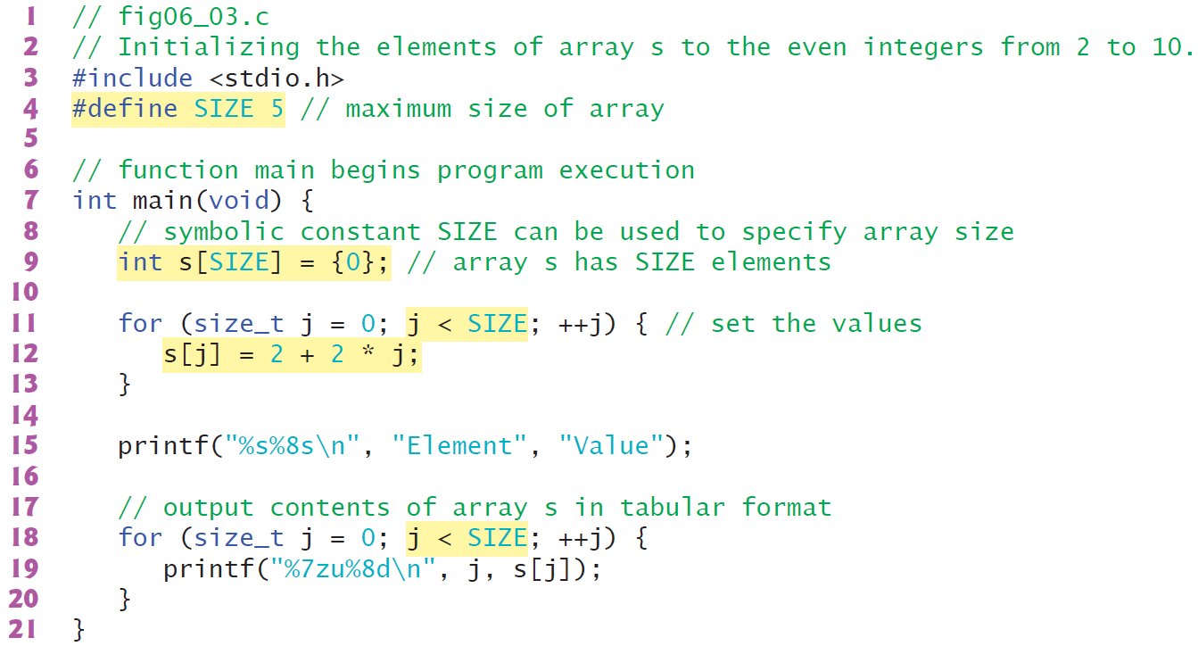
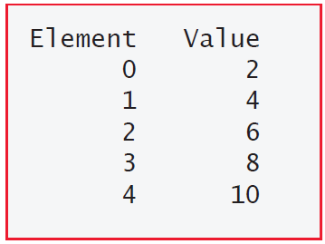
6.4 Array Examples
6.4.3 Specifying an Array’s Size with a Symbolic Constant and Initializing Array Elements with Calculations

Slide 11
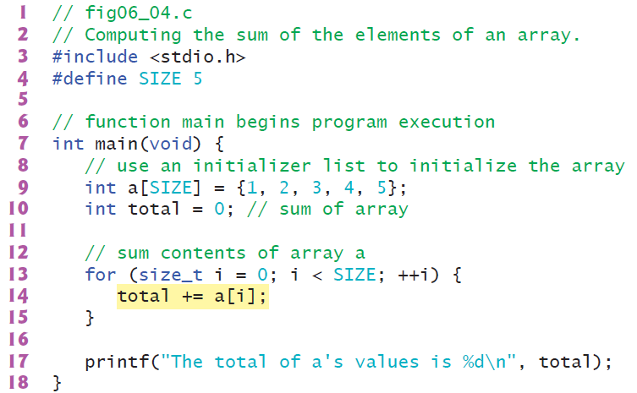

6.4 Array Examples
6.4.4 Summing the Elements of an Array

Slide 12
6.4 Array Examples
6.4.5 Using Arrays to Summarize Survey Results
Twenty students were asked to rate the quality of the food in the student cafeteria on a scale of 1 to 5 (1 means awful, and 5 means excellent). Place the 20 responses in an integer array and summarize the results of the poll.

Slide 13
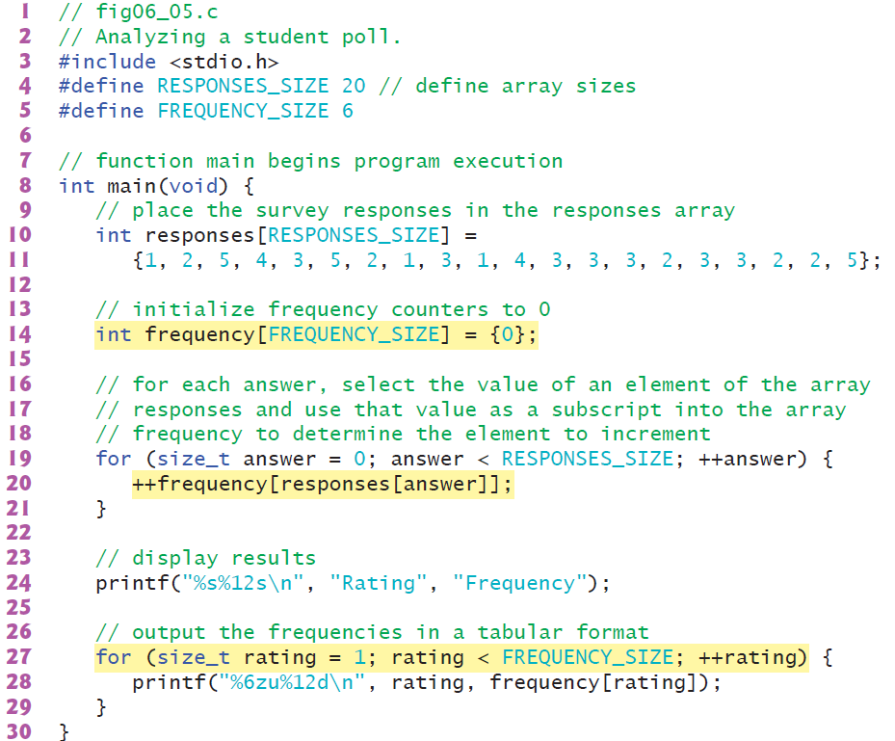
6.4 Array Examples
6.4.5 Using Arrays to Summarize Survey Results

Slide 14
6.4 Array Examples
6.4.5 Using Arrays to Summarize Survey Results

Slide 15
6.4 Array Examples
6.4.5 Using Arrays to Summarize Survey Results

Slide 16
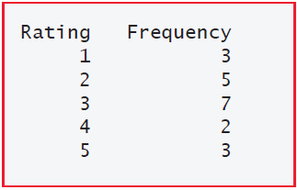
6.4 Array Examples
6.4.5 Using Arrays to Summarize Survey Results

Slide 17
6.4 Using Character Arrays to Store and Manipulate Strings
6.4.5 Using Arrays to Summarize Survey Results
An array is a group of elements of the same type stored contiguously in memory.
To refer to a particular location or element in the array, we specify the array’s name, followed by the element’s position number in square brackets ([]).
The first element is located at position number 0 (zero). The position number is called the element’s subscript (or index). A subscript must be a non-negative integer or integer expression.

